Slide 1
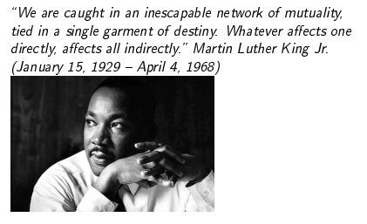
We are all connected!

Slide 2
Networks
Many real world systems can be viewed as a network i.e., collection of nodes inter-linked to one another
Node: A unit, can be a person, organization, computer etc.
Interaction: relationship, friendship, colleagues… (directed or not)
World Wide Web (WWW)
2.4 billion users, 50 billion web pages, 600 million web servers, 20 million DNS servers …

Slide 3
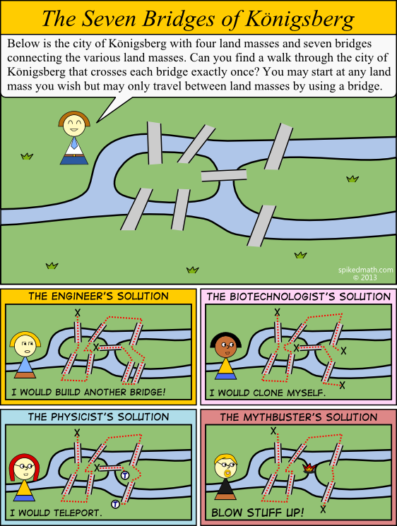
Konigsberg’s Bridges
Solved by Leonhard Euler solved it in 1736, using a graph
Became the pioneering work in graph theory

Slide 4
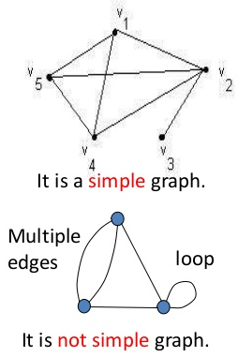
Simple (General) Graphs
G = (V, E) is a graph consisting of V and E
V = {v₁, v₂, v₃, …, v_{N}} is a set of objects called vertices
E = {e₁, e₂, e₃, …, e_{k}} is a set of links called edges
Such that an edge e_{ij} exists between two vertices (v_{i}, v_{j})
But have no
Self edges i.e., the a vertex sharing an edge with itself e_{aa}
Some graphs may allow multiple edges between the same vertices!

Slide 5
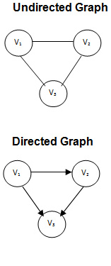
Directions in Graphs
Graphs may be
Unidirectional (Directed graphs)
or
Bidirectional (Undirected graphs)

Slide 6
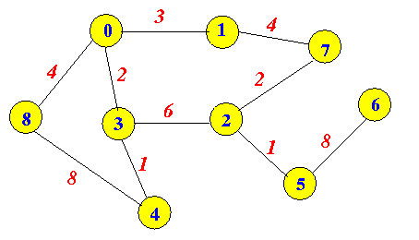
Weighted Graph
A weighted graph is a graph in which each branch is given a numerical weight. A weighted graph is therefore a special type of labeled graph in which the labels are numbers (which are usually taken to be positive).

Slide 7
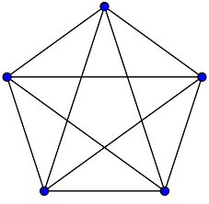
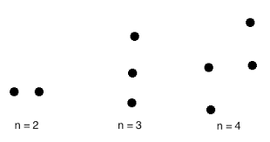

Complete Graph
G = (V, E) where each pair of distinct vertices are adjacent and total number of vertices > 1
The total edges in the graph, K_{N} are
$$K_{N}=\frac{N(N−1)}{2}$$
Null Graph
G = (V, E) where E is a null set
The vertices are there but not linked to one another

Slide 8
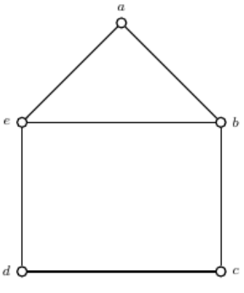
Example
List all vertices and edges
List all vertices that are adjacent to each other i.e., sharing a direct edge
Which vertex has the most number of edges

Slide 9
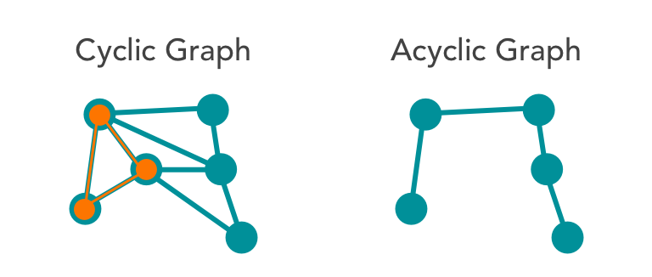
Cyclic or Acyclic Graphs
A graph having cycles or loops is called cyclic graph
Graphs without cycles or loops is called acyclic graph

Slide 10
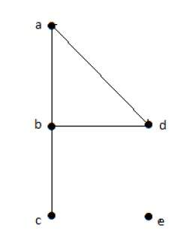
Isolated, Pendant Vertex
An isolated vertex v is the one having no incident edge, i.e., d (v) = 0.
A vertex v having d (v) = 1 is called a pendant vertex.

Slide 11

Theorems
The sum of degrees of all vertices in a graph G, is twice the number of edges in G,
$$\sum_{i=1}^{N}{\deg\left(v_{i}\right)=2e}$$
The number of vertices of odd degree in a graph G, is always even

